Slide 1




Aswan Solar Panels: Machine Learning
Presenters: Lama 320230029 – Rim 320230032
Supervisors: Dr. Ahmed Anter – ENG. Sama al Qasaby

Slide 2
Introduction
Solar energy is a key renewable energy source
Power generation depends heavily on weather conditions
Accurate prediction helps energy planning and grid stability
Focus on solar energy production in Aswan, Egypt

Slide 3

Problem Statement
Solar output varies daily due to weather
This variability affects energy planning
Manual estimation is unreliable
Need for automated prediction using data

Slide 4


Objectives
Analyze Aswan weather dataset
Preprocess and engineer features
Apply feature reduction techniques
Compare classical ML classifiers
Select the best generalizing model

Slide 5
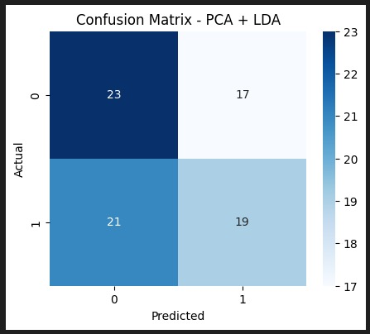
Related Studies
  Classical ML widely used in solar prediction
  PCA and LDA improve efficiency
  Temperature and humidity are key predictors
  Supports model selection in this project

Slide 6
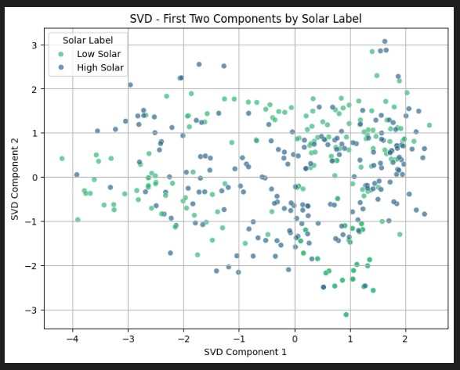
Methodology Used
Exploratory Data Analysis (EDA)
Statistical analysis and binning
Feature reduction: PCA, LDA, SVD
Classification models
Performance evaluation metrics

Slide 7
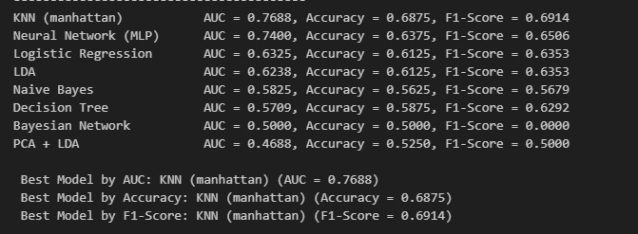
Proposed Architecture
Weather data input
Data preprocessing and scaling
Feature engineering and reduction
Model training
Performance evaluation

Slide 8
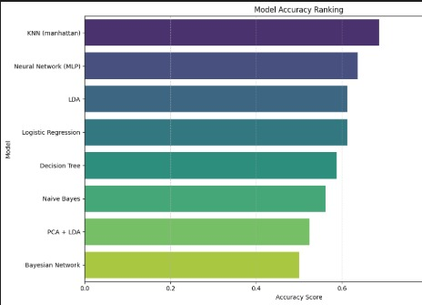
Results and Discussion
PCA retained most data variance
LDA improved class separation
K-NN achieved highest accuracy (72.5%)
Decision Tree showed overfitting

Slide 9

Future Work
Time-series modeling
Larger and richer datasets
Additional weather features
Ensemble learning methods

Slide 10
Thank You

